Slide 1
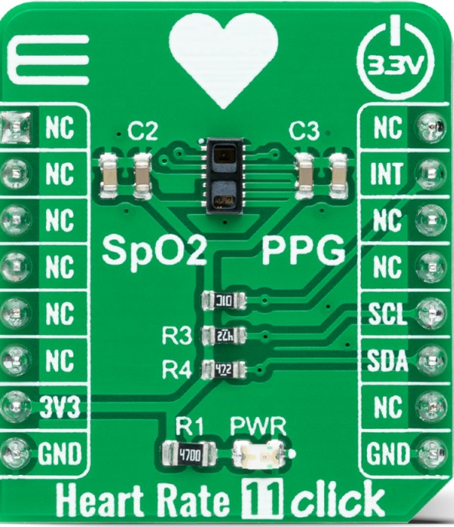

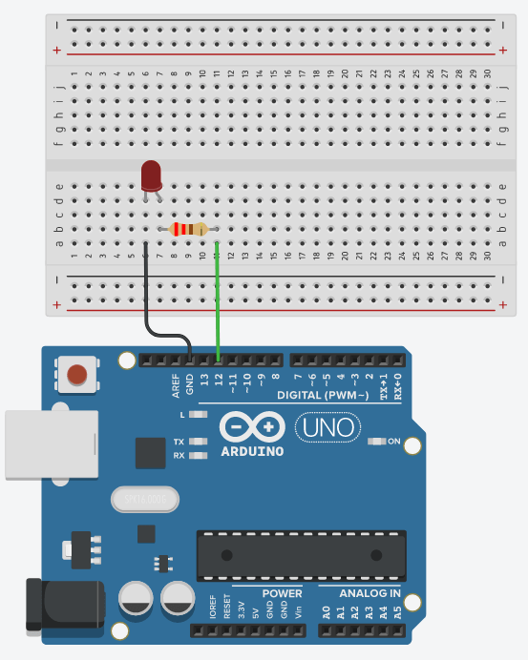
Team: Name ExPulse Team |  | GitHub: https://github.com/peterlu15-lgtm/biofeedback-Group-5-.git
Scrum Master | Hardware Lead | Software Lead | Integration Lead
Nathan Hong | Anwitha Sanivarapu | Yitian Lu | Audrey Chiang
Sprint Planning Board 2
User Stories
ID | User Story | Acceptance Criteria | Priority
US0 | As a user, I want the system to calculate my BPM accurately from the PPG signal | BPM calculated and updated every 5 seconds | H
US1 | As a user, I want to see my live pulse waveform live on screen. | Signal updates every 20 Hz | M
US2 | As a user, I want the system to identify my Heart Rate Zone (e.g., Warm-up, Fat Burn, Peak) based on my BPM. | The zone is mapped and remembered every 5 seconds. | H
Sprint: 2 | Start: 13/02/2026 |  | End: 20/02/2026
Sprint Goal
Develop digital filters to clean the raw sensor data and replace the wired connection with an (e.g HC-05 Bluetooth serial link) to achieve stable wireless data transmission
Definition of Done
Code pushed to GitHub Code well commented Hardware wired cleanly |  | Demo works live Short demo video recorded (≤1 min) README and Manual updated with instructions
Task Breakdown
Task | Linked User Story | Owner | Estimated Hours
Implement a 0.5-4Hz band-pass filter to extract clean PPG peaks from noisy raw data. | US0, US1 | Yitian Lu | 5-7
Develop logic to classify heart rate zones (e.g., warm-up, active) and detect motion artifacts. | US0,1,2 | Yitian Lu | 2-3
Update MATLAB GUI to visualize dual-channel data and display real-time classification results. | US0 | Nathan Hong | 3-5
Basic setup of HC-05 Bluetooth to ensure wireless serial streaming is viable. | US2 | Anwitha, Audrey | 3
System Architecture
Input
Controls
Output
PPG Device
Arduino + PC
Bluetooth (HC-05)
A MATLAB GUI +
LED
I2C Bus
Risks & Unknowns
Risk | Likelihood | Mitigation Plan
Noisy signal | H | Add shielding and digital filter
Skin Contact & Sweat | H | Use tape or Velcro to keep the sensor tight and dry
User Discomfort | M | Design a lightweight, low-profile housing to minimize friction during exercise.
Wire.h Library
Wireless Serial
~$35
https://www.arduino.cc/
+ Digital Filtering
https://docs.arduino.cc/
~$50
https://www.arduino.cc/
~$30
https//www.mikroe.com

Slide 2
Team: ExPulse Team | GitHub: https://github.com/peterlu15-lgtm/biofeedback-Group-5-.git
Standup Board
Go around the room and prepare a team summary of progress.
Sprint: #1 | Start: 13/02/2026 | End: 20/02/2026
Around the Room Filled in by each individual before or during Standup
Scrum Master | Hardware Lead | Software Lead | Integration Lead
Nathan Hong | Anwitha Sanivarapu | Yitian Lu | Audrey Chiang
What I completed since last standup
Nothing | Build up the circuit | Wrote the code to pick up raw data from the ppg sensor | Worked with Anwitha to build up the circuit
What I’m working on today
Looking into bluetooth / wireless | Looking into bluetooth / wireless | Figure out a digital filter, calculate and classify the BPM | Looking into bluetooth / wireless
Blockers (Be specific: hardware, code bug, merge conflict, unclear requirement, etc.)
none | Mikroe shield incompatibility (using breadboard) | Validating Sampling Rate consistency between sensor and Arduino | Mikroe shield incompatibility (using breadboard)
GitHub Metrics Filled in by Software Lead before or during Standup
Metric | Value
# Commits
# Contributors
# Files Changed
Hardware List Filled in by Hardware Lead before or during Standup
Item | Status
Mikroe EEG Click Board | In team’s possession
Mikroe Shield | In team’s possession
Arduino Uno | In team’s possession
Team Summary Filled in by Scrum Master during Standup
Question | Team Answer
Are we on track for our sprint goal? | Yes
Any major integration risks? | Yes
Do we need instructor help? | Yes

Slide 3
Team: : ExPulse Team | GitHub: https://github.com/peterlu15-lgtm/biofeedback-Group-5-.git
Retrospective Board
Reflect on this past week and propose improvements for the future.
Sprint: # | Start: Date | End: Date
Sprint Goal Recap
We successfully achieved the goal of real-time raw data acquisition from the PG sensor. Evidence of this progress can be seen in our IR/Red data streams( screenshots here and the video uploaded on canvas)
What We Learned
Technical | Team
Example | Example
What Went Well? | What Didn’t Go Well?
We successfully pulled raw IR/Red data from the sensor via I2C. The signal quality is surprisingly clearer than we thought. | The Mikroe shield was incompatible with our sensor, forcing us to spend extra time rewiring the entire system on a breadboard The system’s current size exceeds our initial expectations, which may hinder mobile testing and user comfort.
Process Improvements for Next Sprint
Problem | Change We Will Try
Only one person used GitHub | Require another teammate to review commits

